Slide 1


THREAT hunting in okta
DEVIPRIYA S KUMAR

Slide 2
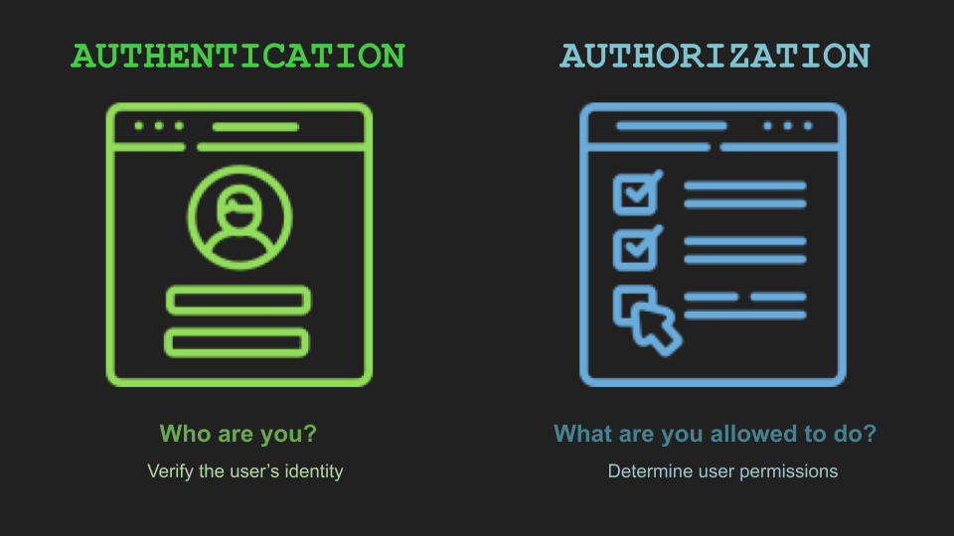
OKTA – HOW IT SIMPLIFIES IDENTITY AND ACCESS MANAGEMENT
cloud identity access management (iam) is a system that enables organizations to govern and manage user access to various cloud-based resources.
it offers a centralized platform where administrators can define and enforce access policies, permissions, and authentication mechanisms for users and groups across different cloud services and platforms.

Slide 3
OKTA
Okta is a cloud-based identity and access management platform.
It enables organizations to securely connect the right people to the right technologies at the right time.

Slide 4
Single Sign-On (SSO): Access multiple applications with just one set of credentials.
01
Multi-Factor Authentication (MFA): Add an extra layer of security with MFA.
02
Universal Directory: Centralize user management across all applications and devices.
03
Lifecycle Management: Automate user provisioning, deprovisioning, and account updates.
04

Slide 5
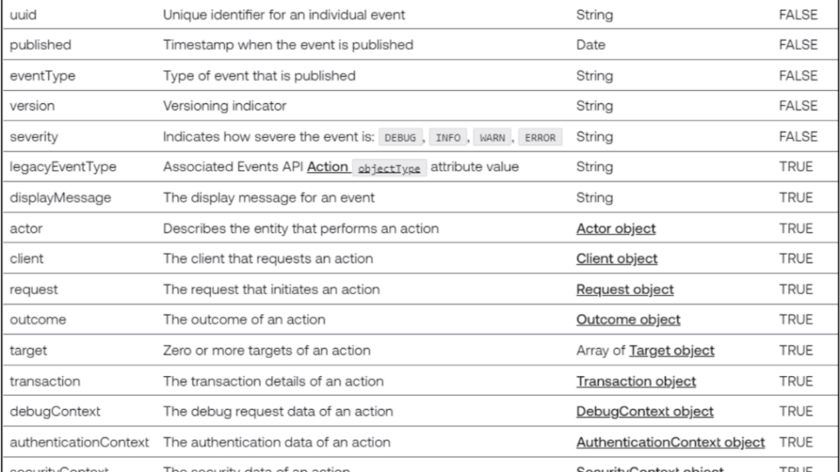
Understanding okta logs
System Log API
Log event attributes
OKTA EventTypes

Slide 6
#1 User Account Hijack Unauthorized access to a user’s account by an attacker Common Attack Techniques: Phishing Credential Stuffing Brute Force Attacks

Slide 7
#2 Password spraying Password spraying is a cyberattack technique used by hackers to gain unauthorized access to multiple user accounts by systematically trying a small number of commonly used passwords against large number of usernames.

Slide 8
#3 Suspicious client takeover In MITRE ATT&CK framework, a "Suspicious Tenant Takeover" is a tactic used by attackers to gain control over a cloud service account (like Microsoft 365 or Google Workspace) in a way that may look unusual or suspicious to defenders.

Slide 9
Admin privileges revoked
Admin privileges revoked refers to the action of removing administrative rights or privileges from a user or account within a system or network.
Administrative Access: Admin privileges typically grant users elevated access levels, allowing them to perform various administrative tasks such as installing software, modifying system settings, and managing user accounts.

Slide 10
Session hijacking
The attacker first identifies a target session they want to hijack.
This could be a user session on a website, an authenticated session in an application, or a network session between two devices
The attacker then intercepts or "sniffs" the communication between the target user and the server to capture the session identifier or token. Once the attacker obtains a valid session identifier, they use it to impersonate the legitimate user and take control of the active session.

Slide 11

MFA Push Notification fatigue
MFA (Multi-Factor Authentication) push notifications fatigue happens when users feel overwhelmed or annoyed by receiving too many push notifications for MFA on their devices.
Attackers may leverage MFA push notifications fatigue as part of social engineering attacks. By impersonating legitimate entities or creating urgency, attackers can trick users into approving fraudulent MFA notifications, leading to account compromise or data breaches.

Slide 12

DEMO USING JUPYTER NOTEBOOK

Slide 13

Fun EXERCISE
Map the above discussed detections to mitre

Slide 14

THANKYOU

